Slide 1
Java Network

Slide 2
Java Networking
Java TCP Networking Basics
Typically a client opens a TCP/IP (Transmission Control protocol / Internet Protocol)connection to a server. The client then starts to communicate with the server. When the client is finished it closes the connection again. Here is an illustration of that:
Application Layer
Transport Layer
Internet Layer
Network Layer

Slide 3
Java Networking
Java Socket's and ServerSocket's
When a client wants to open a TCP/IP connection to a server, it does so using a Java Socket. The socket is told what IP address and TCP port to connect to and the rest is done by Java.
If you want to start a server that listens for incoming connections from clients on some TCP port, you have to use a Java ServerSocket. When a client connects via a client socket to a server's ServerSocket, a Socket is assigned on the server to that connection. The client and server now communicates Socket-to-Socket.

Slide 4
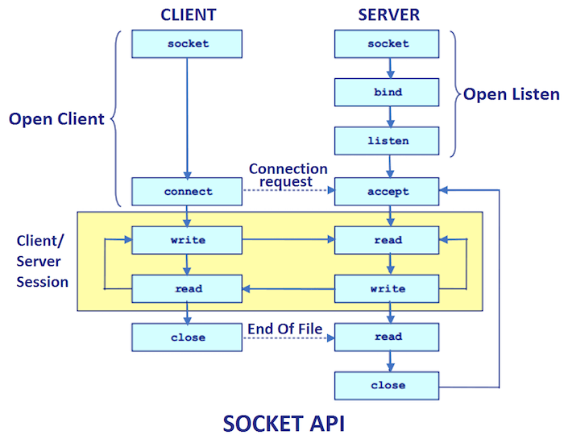

Slide 5
Java Network Basics
Java UDP Networking Basics
UDP works a bit differently from TCP. Using UDP there is no connection between the client and server. A client may send data to the server, and the server may (or may not) receive this data. The client will never know if the data was received at the other end. The same is true for the data sent the other way from the server to the client.
Because there is no guarantee of data delivery, the UDP protocol has less protocol overhead.
There are several situations in which the connectionless UDP model is preferable over TCP. These are covered in more detail in the text on Java's UDP DatagramSocket's.

Slide 6
TCP
TCP stream of bytes communication
A dedicated point-to-point channel
Use TCP (Transmission Control Protocol) for data transmission.
  For integrity, checksum is used to detect and reject corrupt packets an sequence numbers to detect and reject duplicate packets. For validity, timeouts and retransmission to deal with lost packets.
  So messages are guaranteed to be delivered. Lossless and reliable. Sent and received in the same order.
  Use of TCP: many frequently used services run over TCP connections
  HTTP, FTP, Telnet, SMTP

Slide 7
UDP
UDP datagram communication: attractive due to no overheads associated with guaranteed message delivery
No dedicated point-to-point channel
Use UDP (User Datagram Protocol) for data transmission. No acknowledge and retries.
  Omission failure as messages may be dropped occasionally either because of checksum error or no buffer space at source or destination
  Messages can be sometimes be delivered out of sender order
  So applications using UDP are left to provide their own checks to achieve quality of reliable communication that suffers from omission failures, which can be constructed by using acknowledgements.
  Applications that are acceptable to have occasional omission failure and out of order. For example, DNS and Voice Over IP (VOIP)

Slide 8
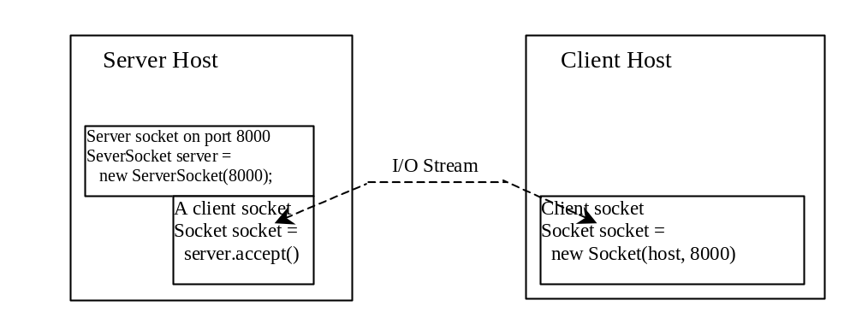
Client/Server Communications: TCP
The server must be running when a client starts. The server waits for a connection request from a client. To establish a server, you need to create a server socket and attach it to a port, which is where the server listens for connections.
After the server accepts the connection, communication between server and client is conducted the same as for I/O streams.
After a server socket is created, the server can use this statement to listen for connections.
The client issues this statement to request a connection to a server.

